Slide 1


Slide 2
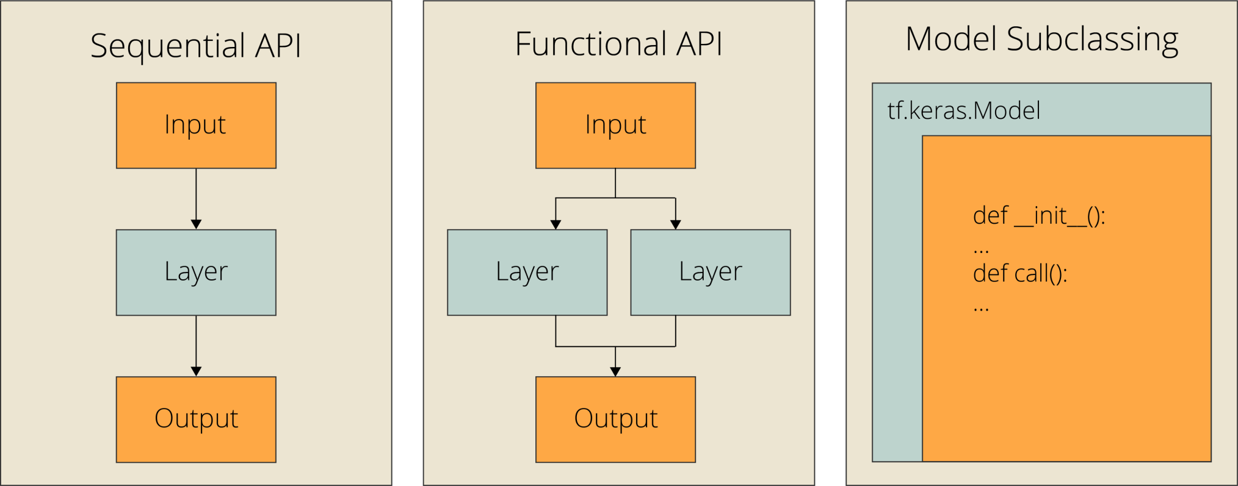
Model construction API’s

Slide 3
Callbacks
There are many built-in callbacks already available in Keras, such as:
ModelCheckpoint: Periodically save the model.
EarlyStopping: Stop training when training is no longer improving the validation metrics.
TensorBoard: periodically write model logs that can be visualized in TensorBoard (more details in the section "Visualization").
CSVLogger: streams loss and metrics data to a CSV file.

Slide 4
Custom Layers
Custom Dense neural network Layer
Custom Activation Function
Custom Loss Function

Slide 5
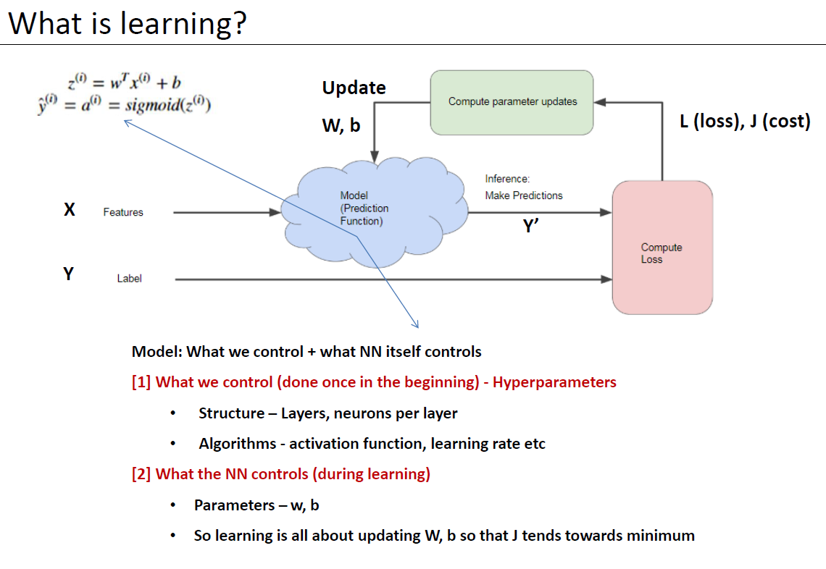

Slide 6
Custom models
Multi output model
Energy Efficiency dataset
Multi input model
Simese neural network

Slide 7
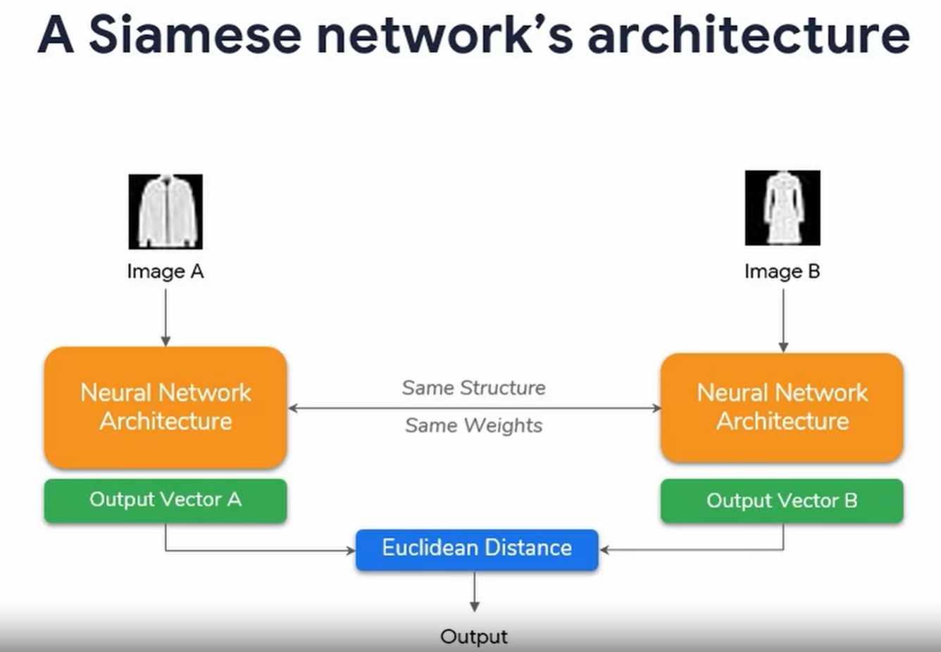

Slide 8
TFRecords
Tensorflow’s own binary storage format
Helpful in working with Large datasets
Advantages:
fasters data access (binary format)
Reduces training time
Optimized for use with Tensorflow in multiple ways
Combine multiple datasets
Pre-processing functionality
Store sequence data — for instance, a time series or word encodings

Slide 9
Usage of TFRecords:
tf.train.Feature wraps a list of data of a specific type
1. tf.train.BytesList:
- string
- byte
2. tf.train.FloatList:
- float (‘float32’)
- double (‘float64’)
3. tf.train.Int64List:
- bool
- enum
- int32
- uint32
- int64
- uint64

Slide 10
Tensorflow provides two components for this purpose: tf.train.Example and tf.train.SequenceExample.
Each sample of your data in one of these structures, then serialize it and use a tf.python_io.TFRecordWriter to write it to disk.

Slide 11
Handling large datasets in ML & DL pipelines

Slide 12
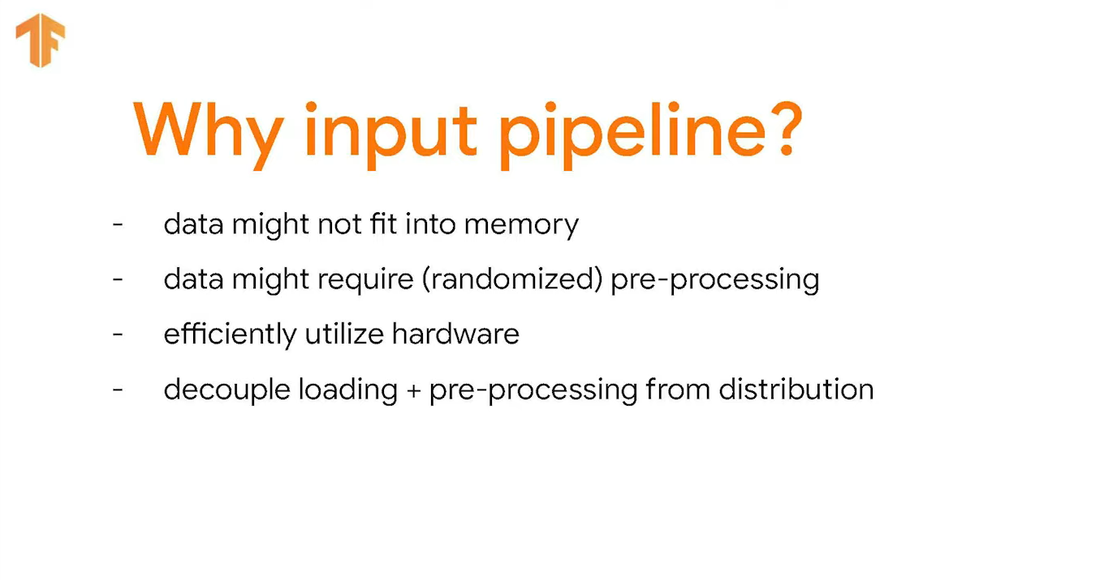

Slide 13
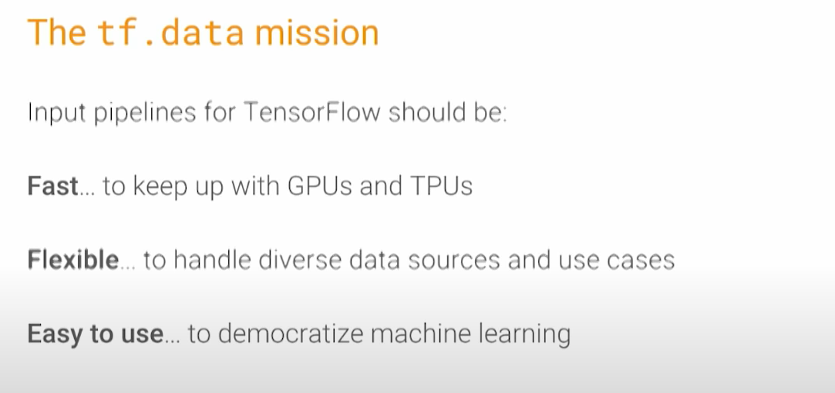
tf.data api
The tf.data API was built with three major focal areas.
Performance
Flexibility
Ease of use

Slide 14
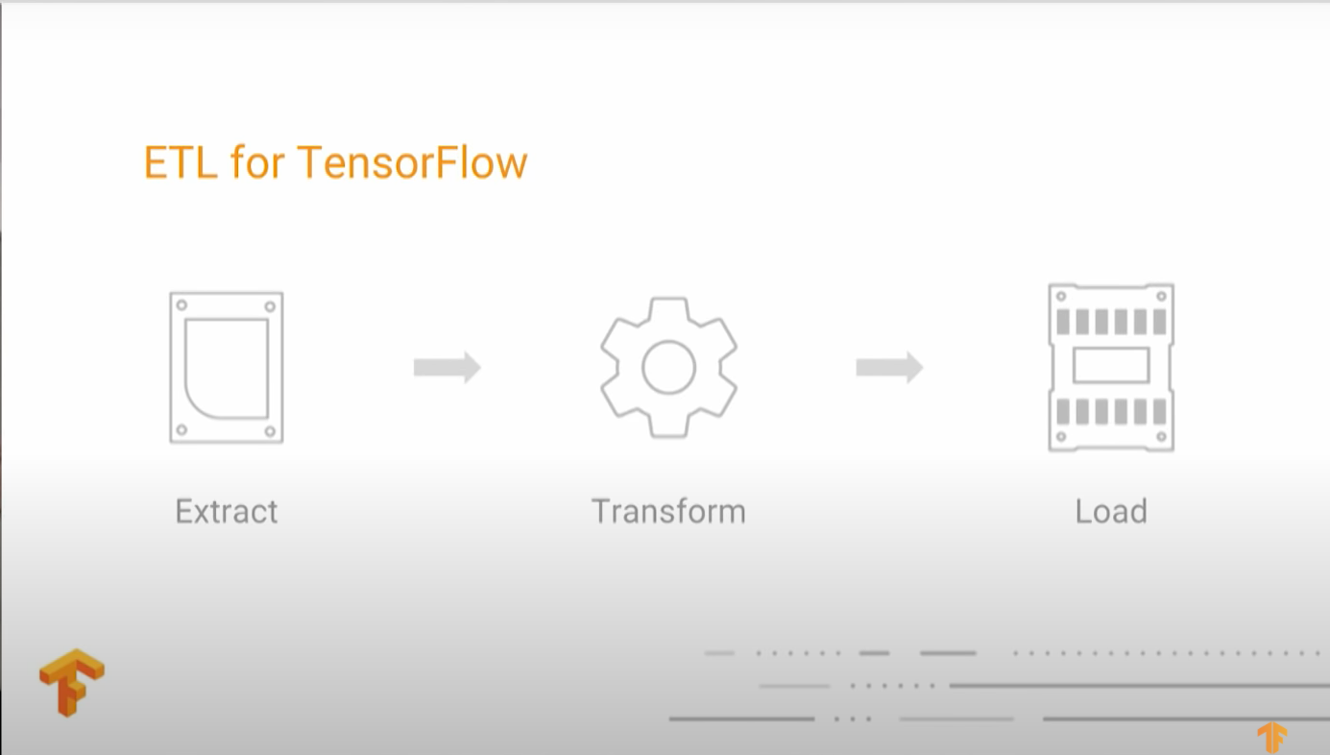

Slide 15
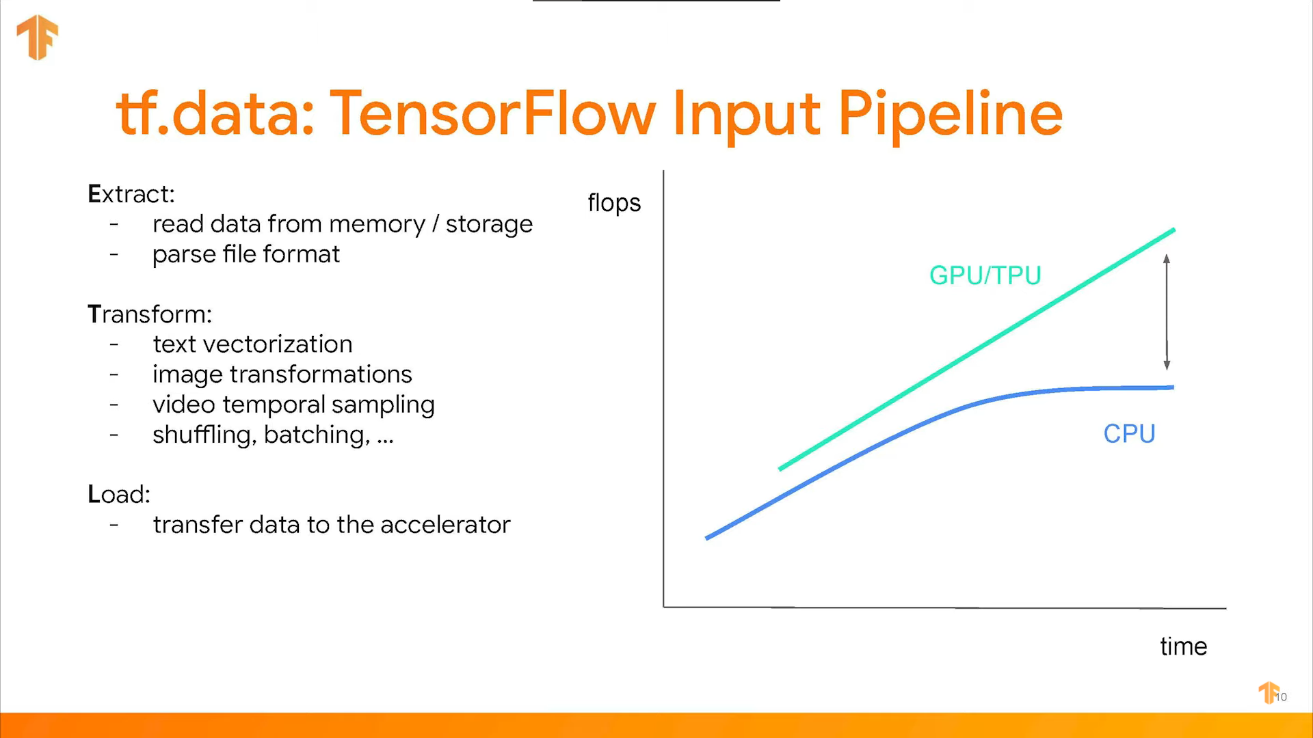

Slide 16
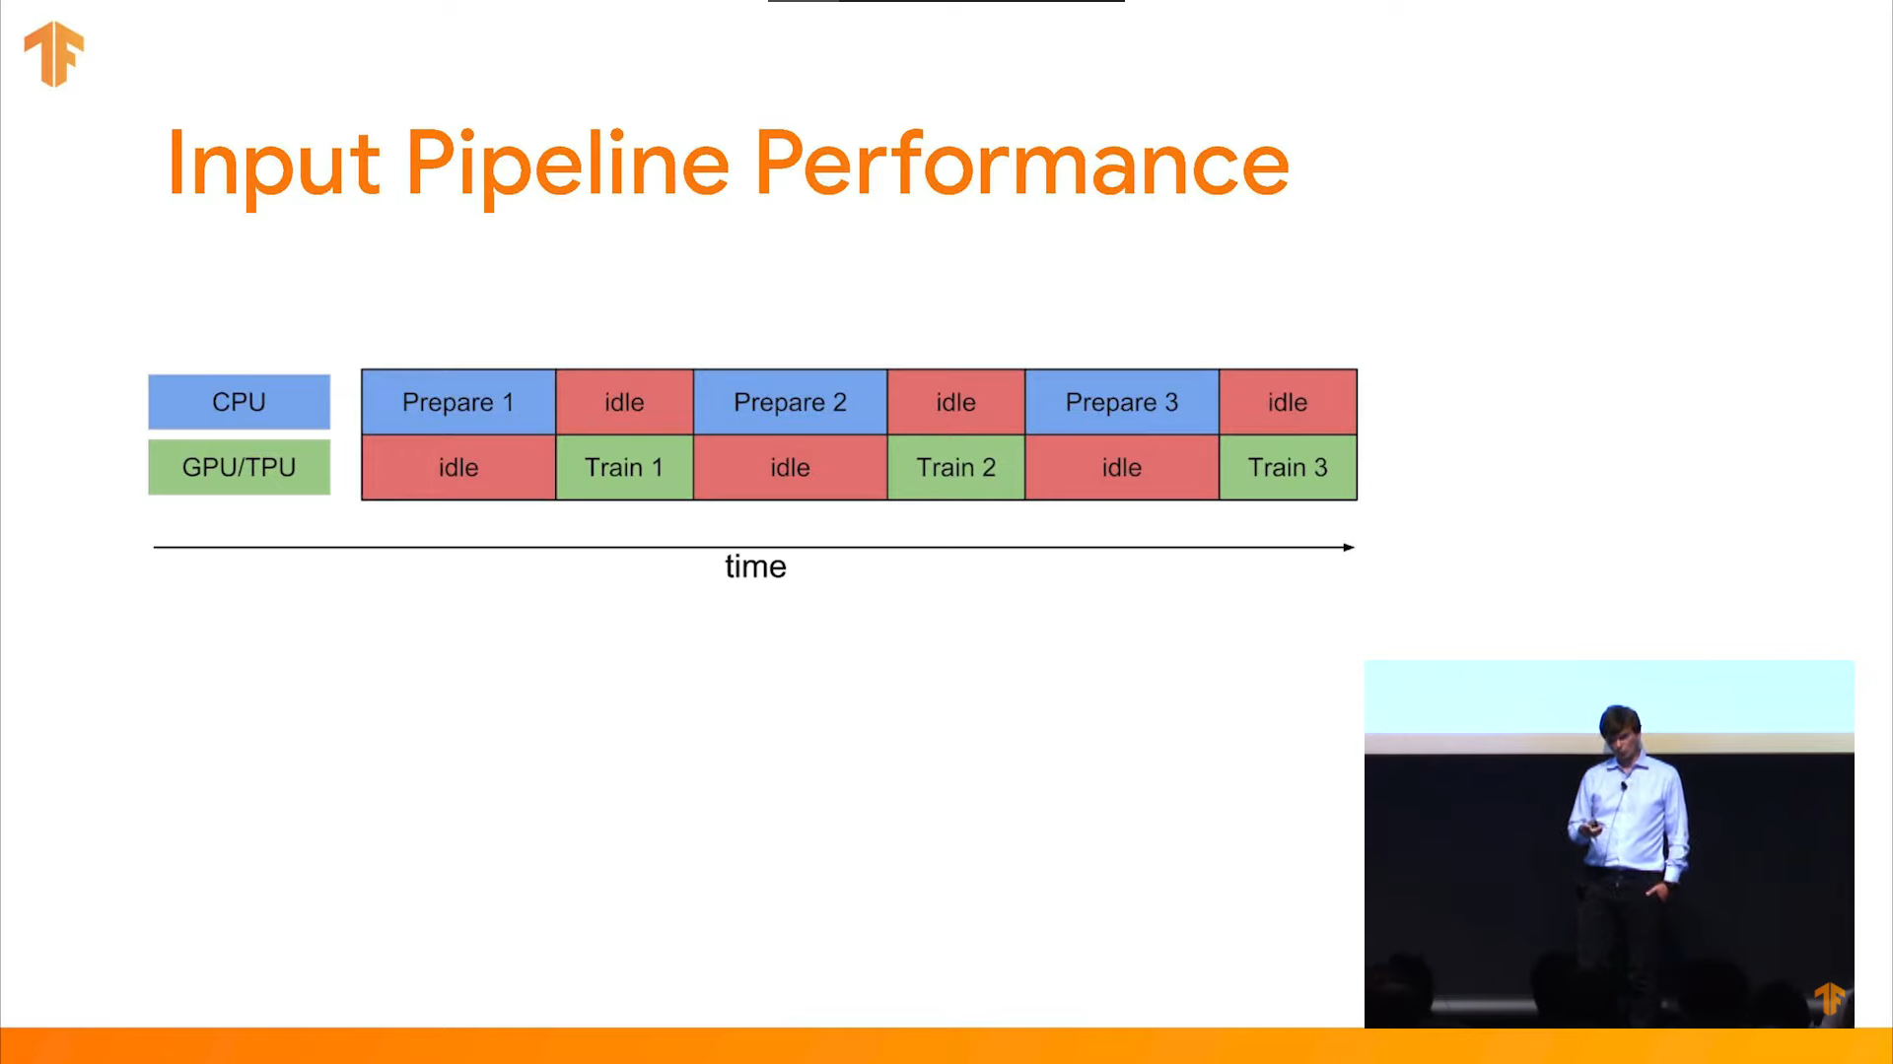

Slide 17
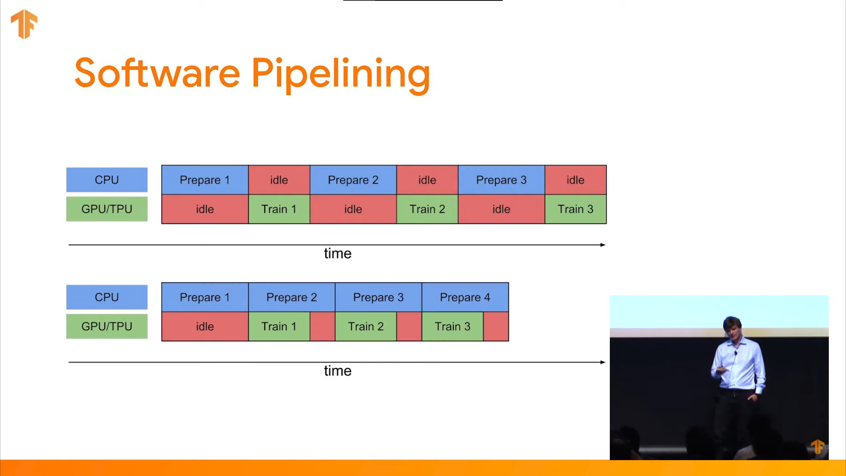

Slide 18
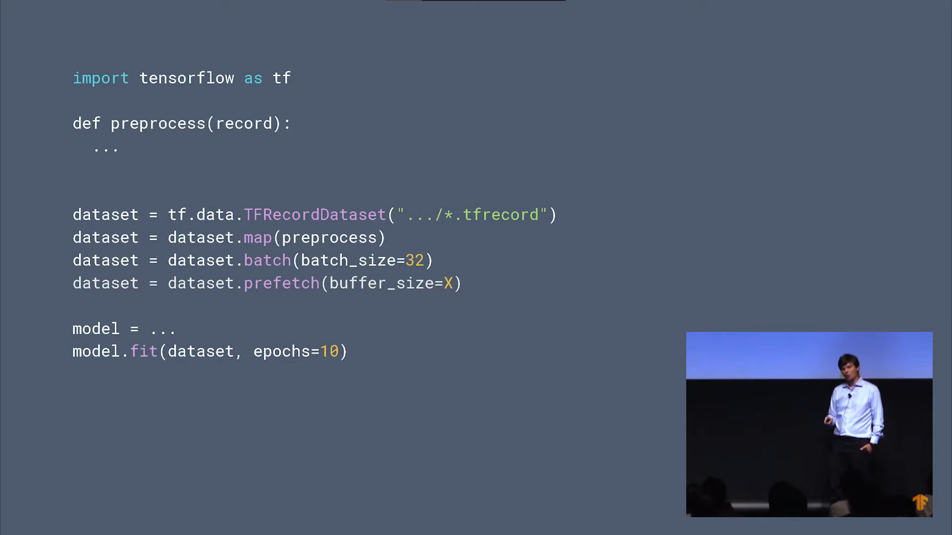
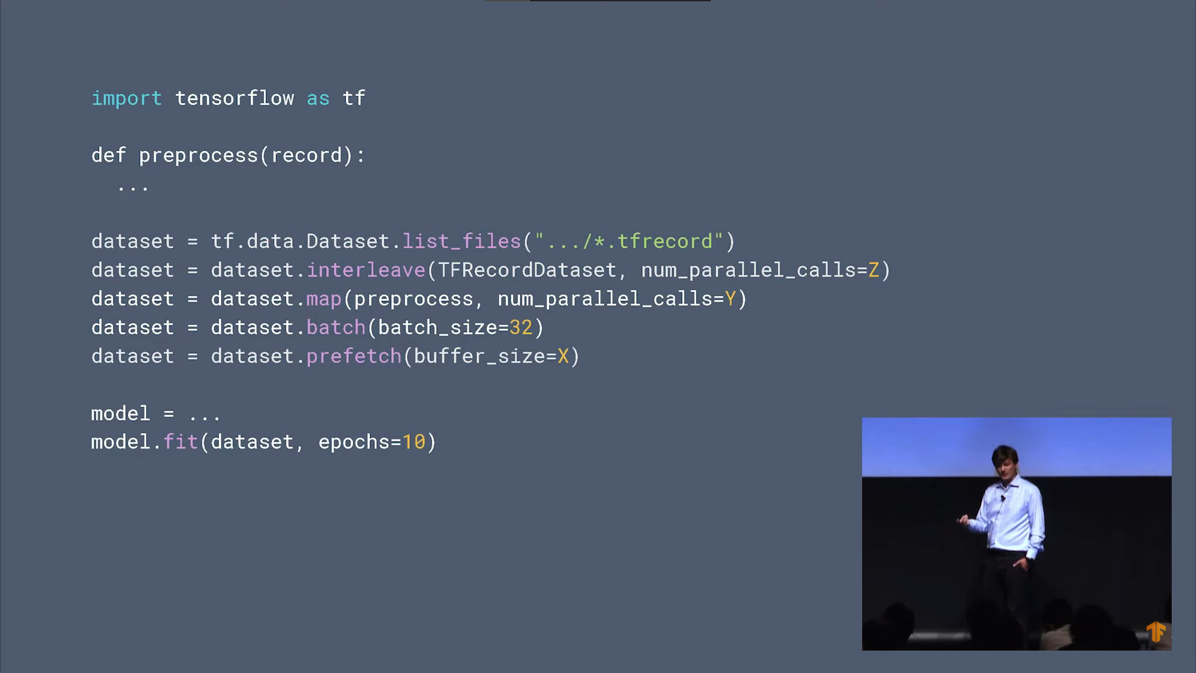

Slide 19
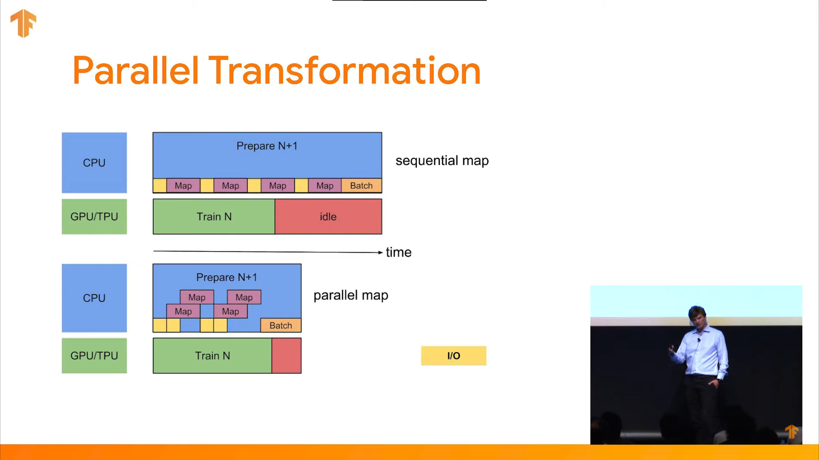

Slide 20
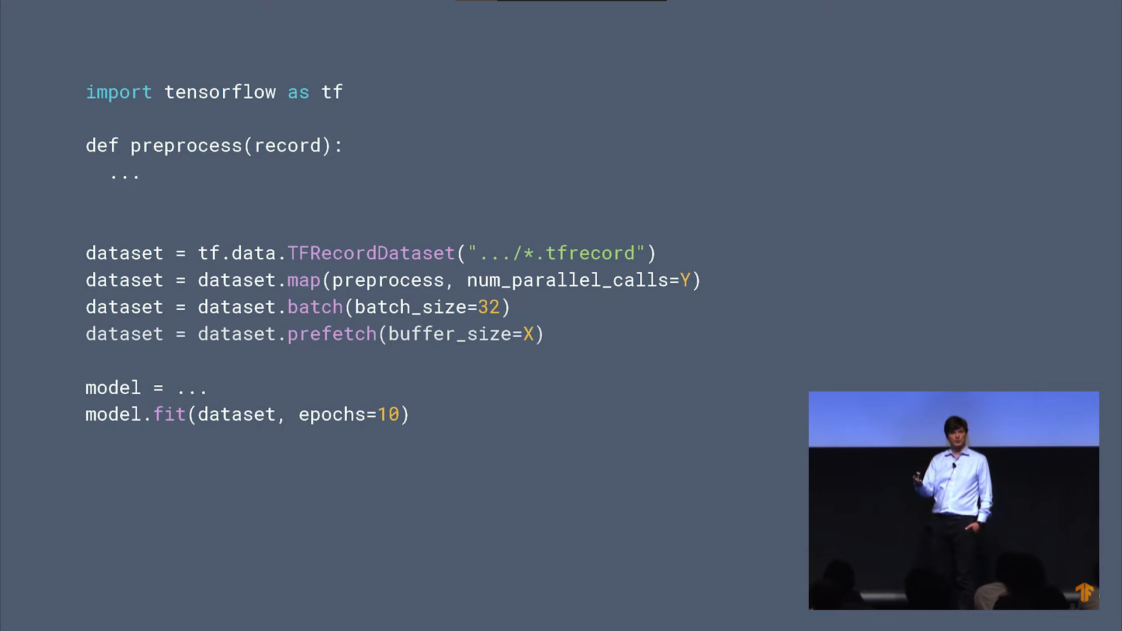

Slide 21
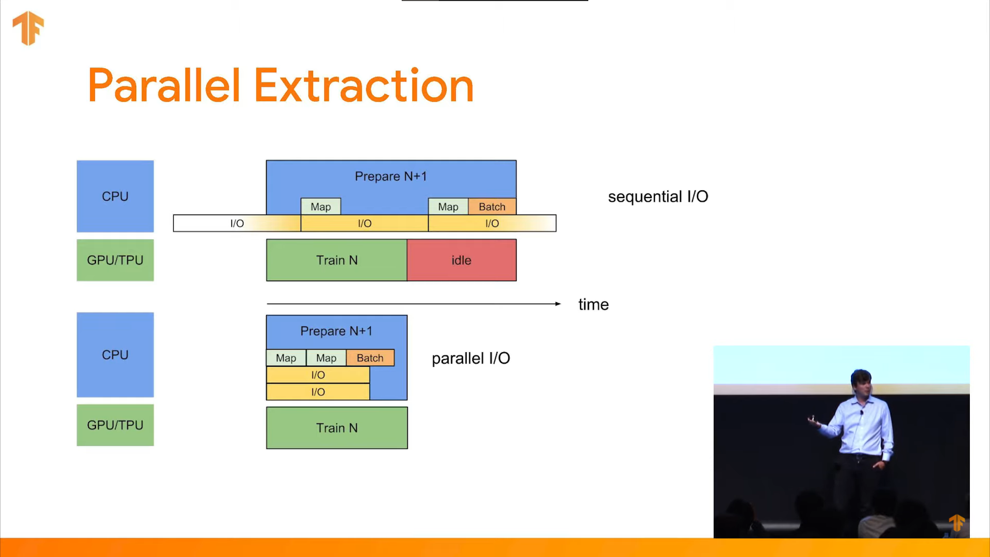

Slide 23
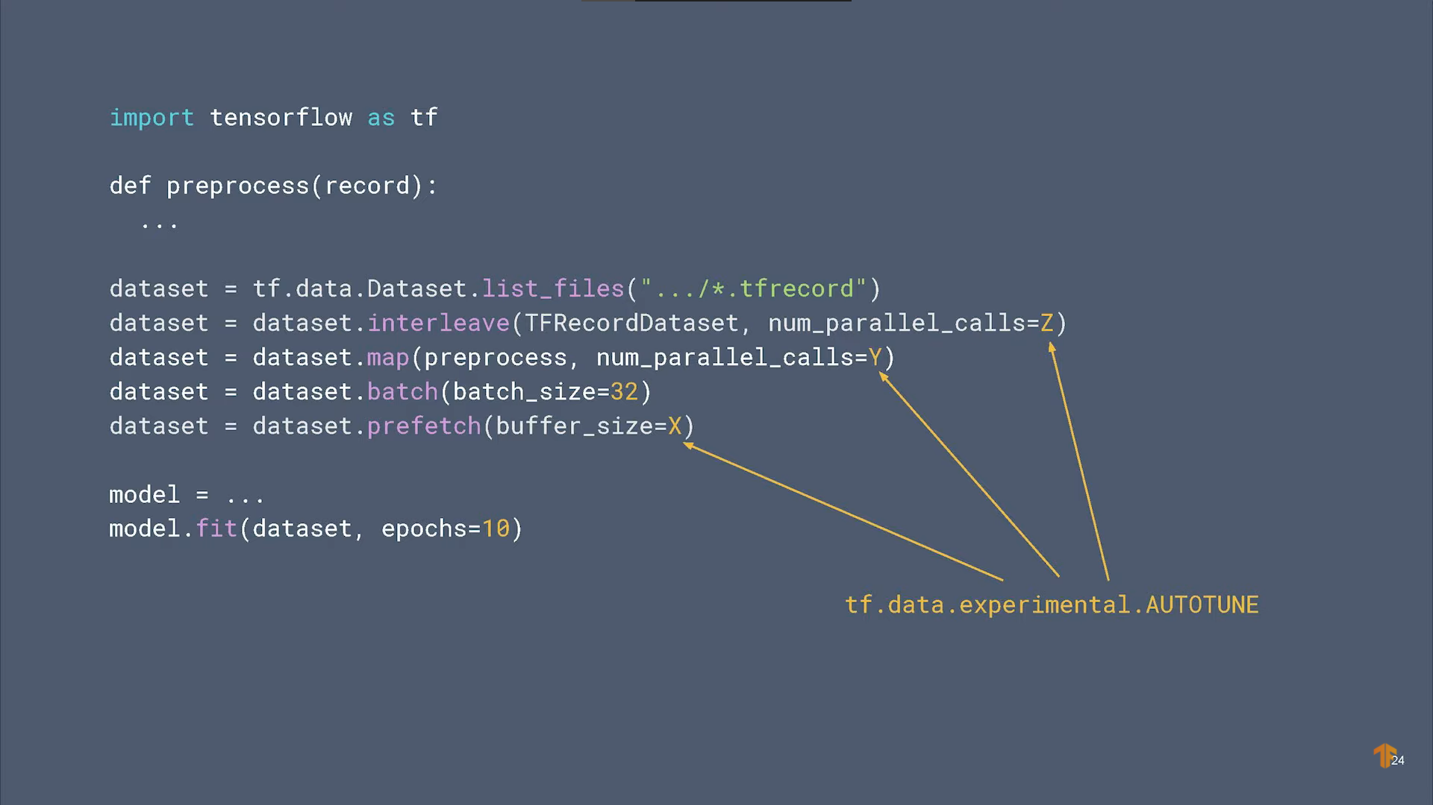

Slide 24
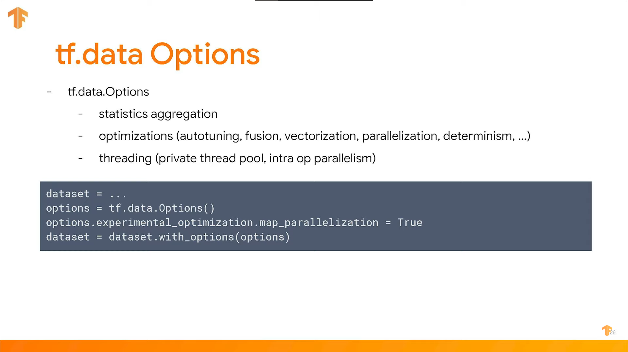

Slide 25
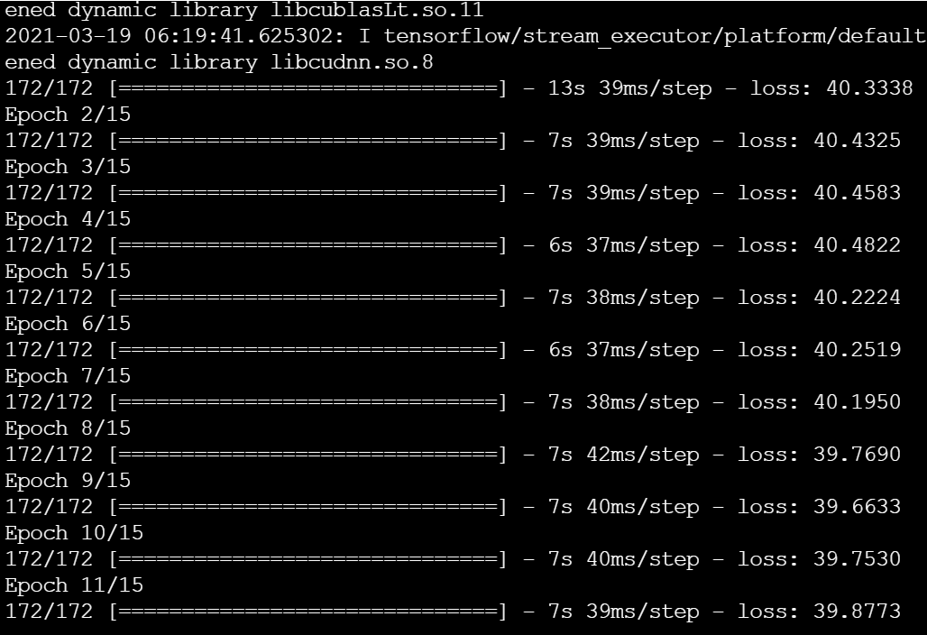
Usage of train_ds.cache reduced training time from 2nd epoch

Slide 26
Reference Links
https://www.youtube.com/watch?v=uIcqeP7MFH0
https://www.youtube.com/watch?v=ZnukSLKEw34
https://www.tensorflow.org/guide/data
https://www.tensorflow.org/guide/data_performance
https://www.tensorflow.org/guide/data_performance_analysis
Code_snippet:
https://zhuanlan.zhihu.com/p/93999898
https://www.kaggle.com/jalammar/intro-to-data-input-pipelines-with-tf-data
https://towardsdatascience.com/how-to-reduce-training-time-for-a-deep-learning-model-using-tf-data-43e1989d2961
https://heartbeat.fritz.ai/building-a-data-pipeline-with-tensorflow-3047656b5095
Similar pipeline tool from NVIDIA (DALI -> Data Loading Library):
https://developer.nvidia.com/blog/gpudirect-storage-moving-data-pipeline-into-the-fast-lane/
Documentation:
https://docs.nvidia.com/deeplearning/dali/user-guide/docs/examples/getting%20started.html

Slide 27

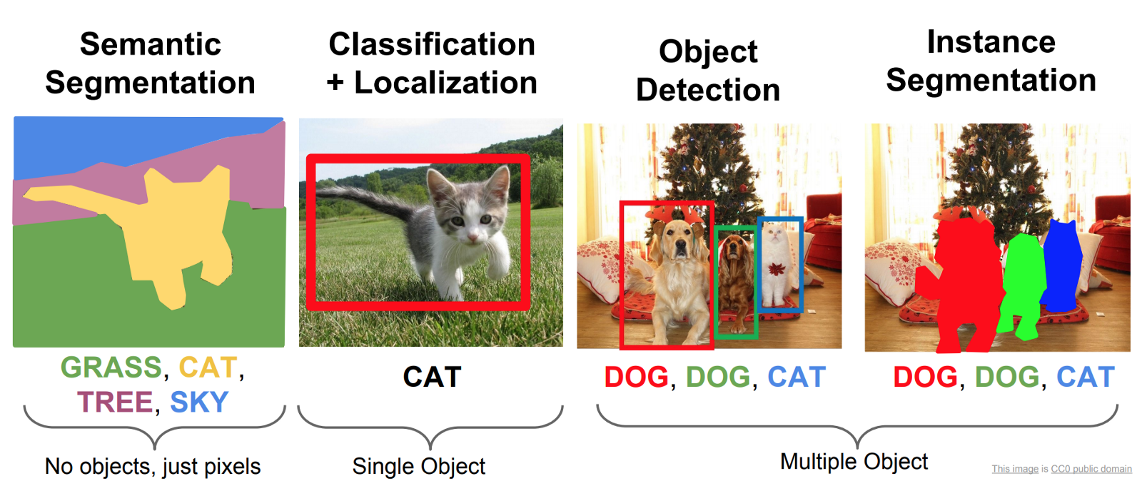
Computer Vision
Image Classification
Object Detection
Segmentation
Instance segmentation

Slide 28

Image classification task

Slide 29
Reference Links
https://guides.lib.umich.edu/c.php?g=282942&p=1885348
https://medium.com/apache-mxnet/multi-channel-convolutions-explained-with-ms-excel-9bbf8eb77108
http://datahacker.rs/what-is-padding-cnn/
https://gfycat.com/affectionatememorablegreyhounddog-artificial-intelligence-neural-networks
https://www.simplilearn.com/tutorials/deep-learning-tutorial/convolutional-neural-network
https://ai.plainenglish.io/building-and-training-a-convolutional-neural-network-cnn-from-scratch-9a64bcc62c1
https://colab.research.google.com/github/lmoroney/dlaicourse/blob/master/Course%202%20-%20Part%202%20-%20Lesson%202%20-%20Notebook.ipynb
https://medium.com/analytics-vidhya/2d-convolution-using-python-numpy-43442ff5f381
https://towardsdatascience.com/building-convolutional-neural-network-using-numpy-from-scratch-b30aac50e50a
http://datahacker.rs/edge-detection/

Slide 30
Depth-wise conv:
https://medium.com/@zurister/depth-wise-convolution-and-depth-wise-separable-convolution-37346565d4ec
CNN Network Architectures Explanation:
https://www.youtube.com/watch?v=DAOcjicFr1Y
https://stackoverflow.com/questions/42883547/intuitive-understanding-of-1d-2d-and-3d-convolutions-in-convolutional-neural-n

Slide 31
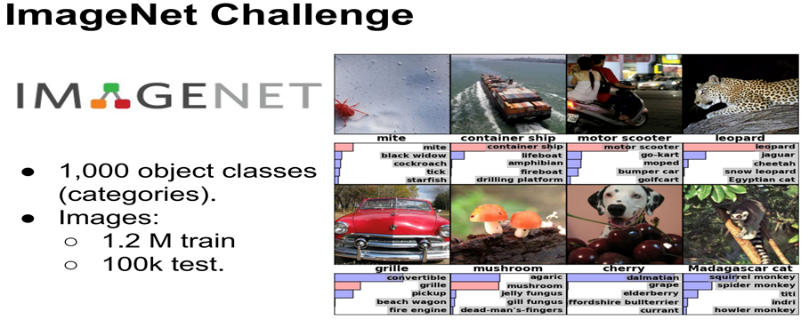

Slide 32
Transfer learning
Know how to ride bicycle -> Learn how to ride motor bike

Slide 33
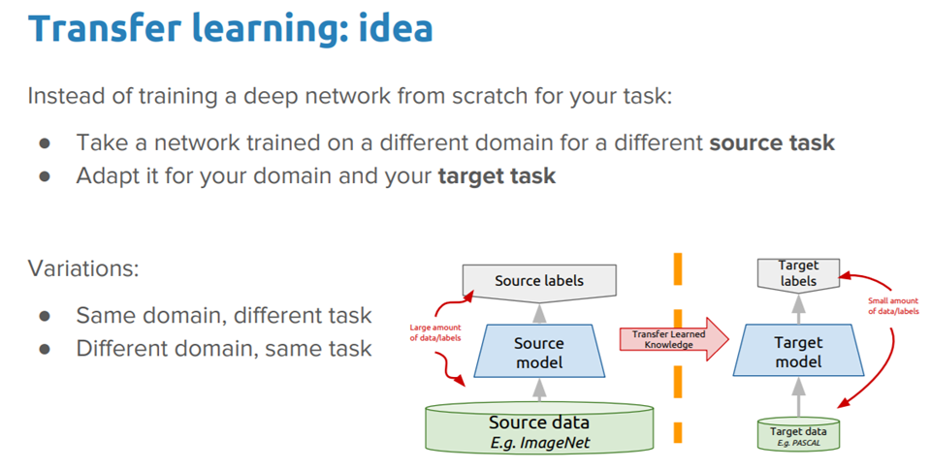

Slide 34
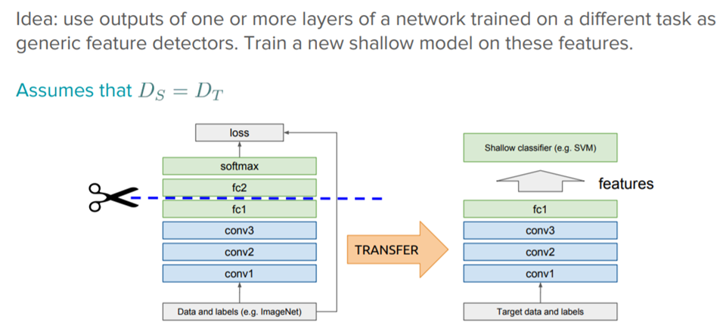

Slide 35
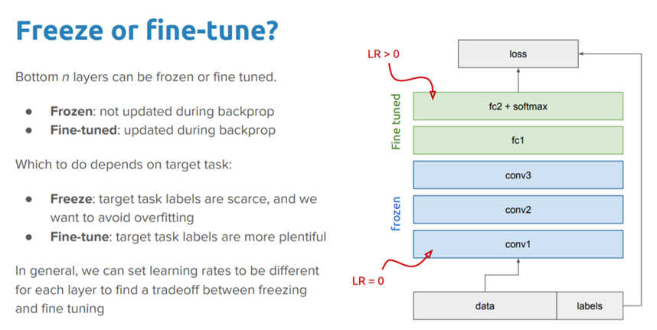

Slide 36
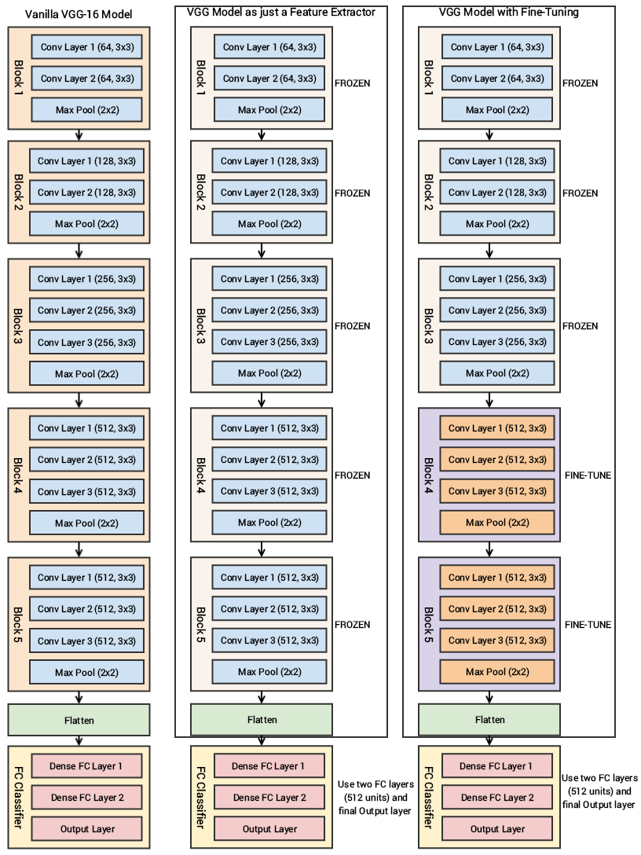

Slide 37
Reference links
Transfer Learning :
https://www.tensorflow.org/tutorials/images/transfer_learning
https://towardsdatascience.com/a-comprehensive-hands-on-guide-to-transfer-learning-with-real-world-applications-in-deep-learning-212bf3b2f27a
MobileNet_V2 :
https://ai.googleblog.com/2018/04/mobilenetv2-next-generation-of-on.html

Slide 38
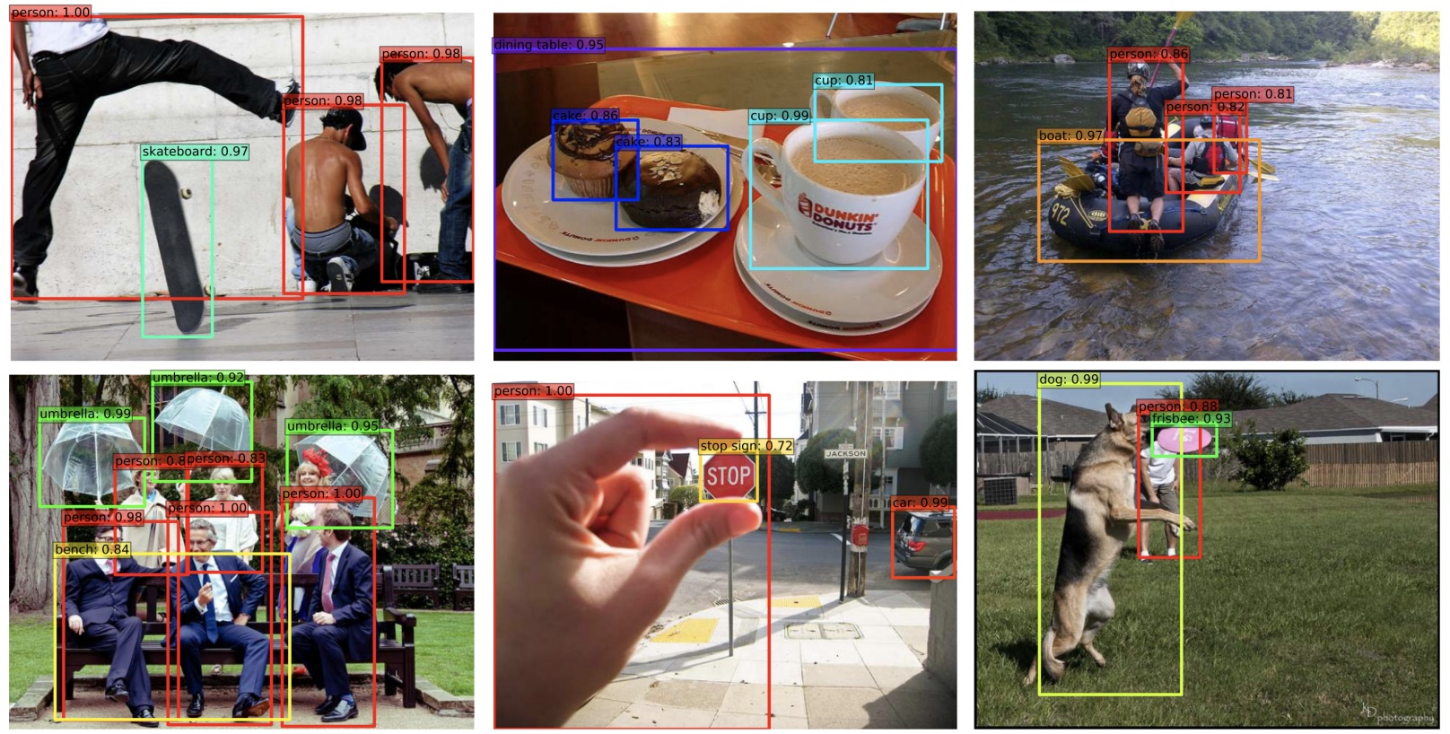
Object Detection
Object detection refers to the task of identifying various objects within an image
and drawing a bounding box around each of them

Slide 39
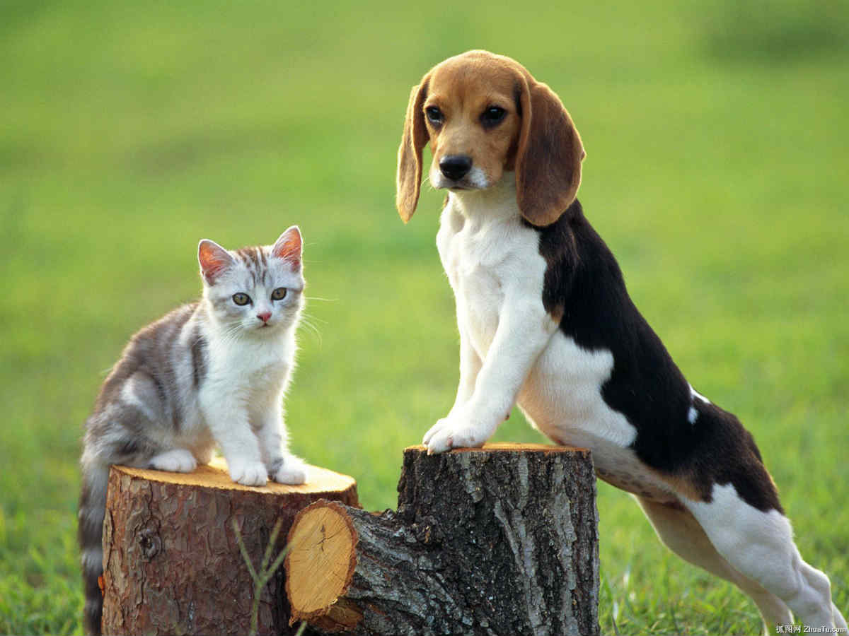
cat
dog

Slide 40
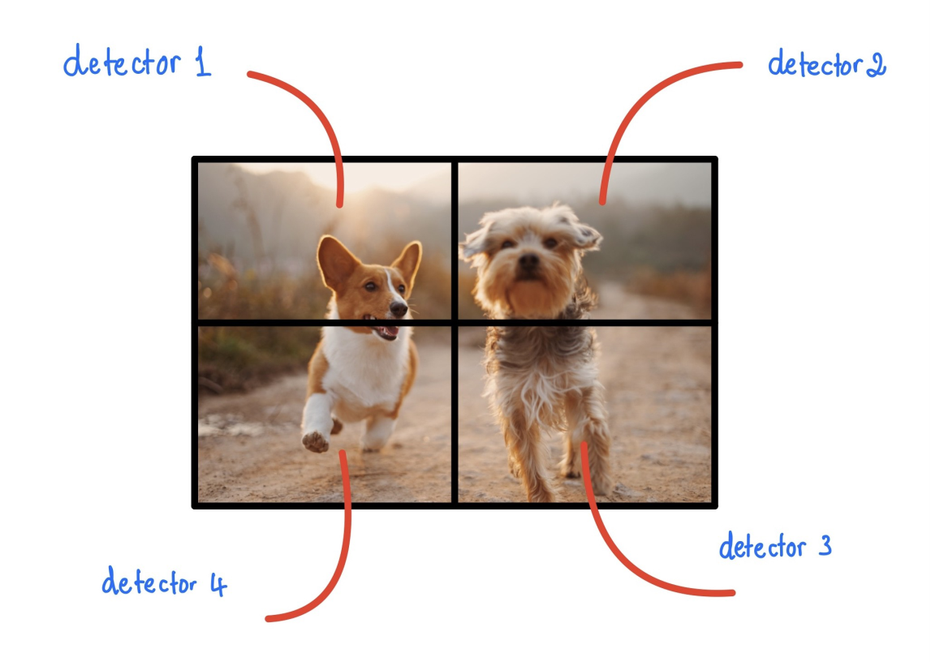
Grid detectors

Slide 41
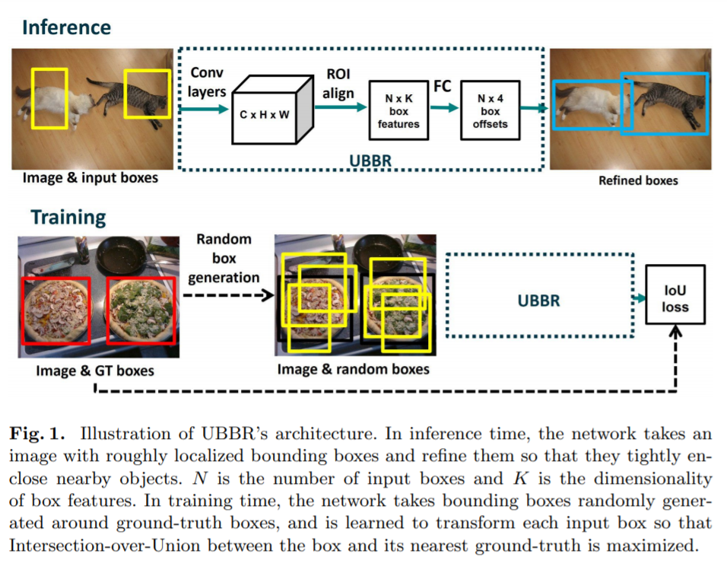
Universal Bounding Box Regression
Image classifier
Softmax layer Output for two boxes seperatley:
cat (0.9)
dog(0.1)
cat (0.9)
dog(0.1)

Slide 42
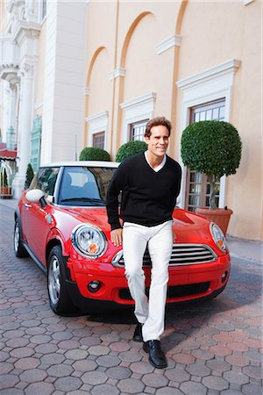
Overlapped Objects

Slide 43
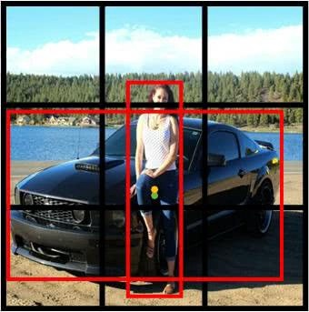
Anchor boxes
helpful to detect multiple overlapping objects as shown in figure.

Slide 44
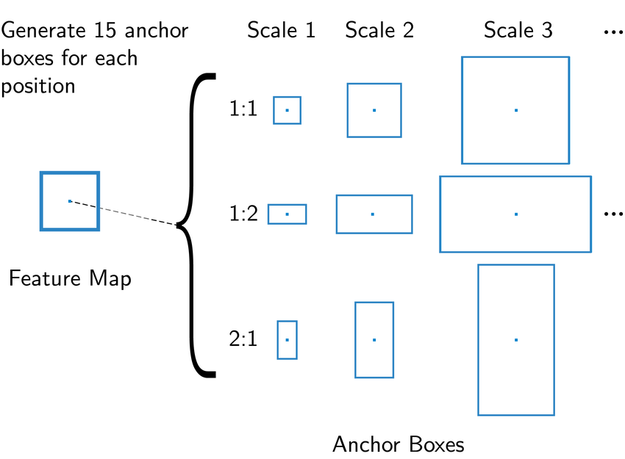

Slide 45
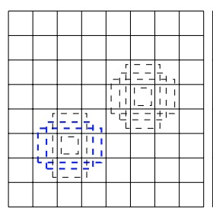
8x8 Feature map with 5 anchor boxes

Slide 46
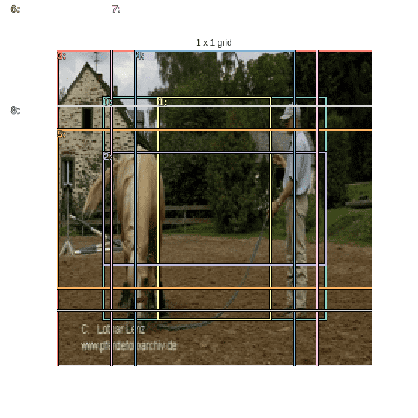
1 x 1 Grid with 8 Anchor Boxes

Slide 47
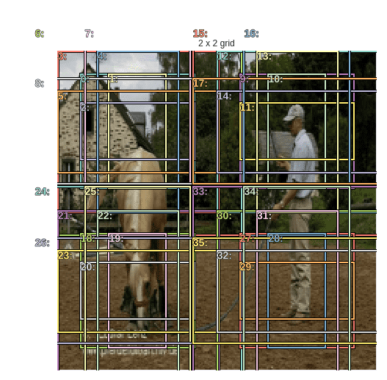
2 x 2 Grid with 4*8 = 32 Anchor Boxes

Slide 48
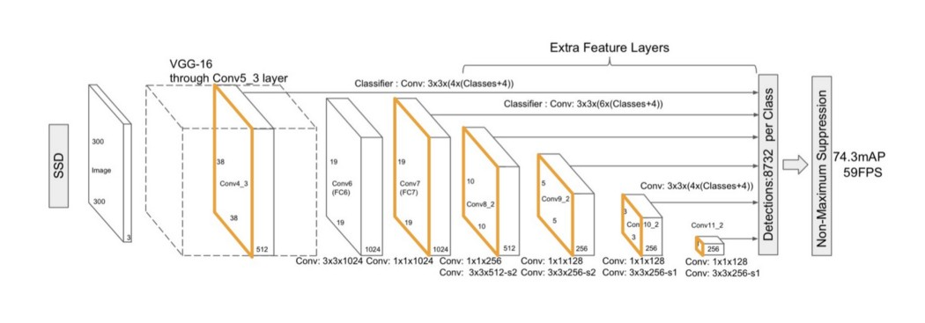
SSD: Single Shot detector

Slide 49
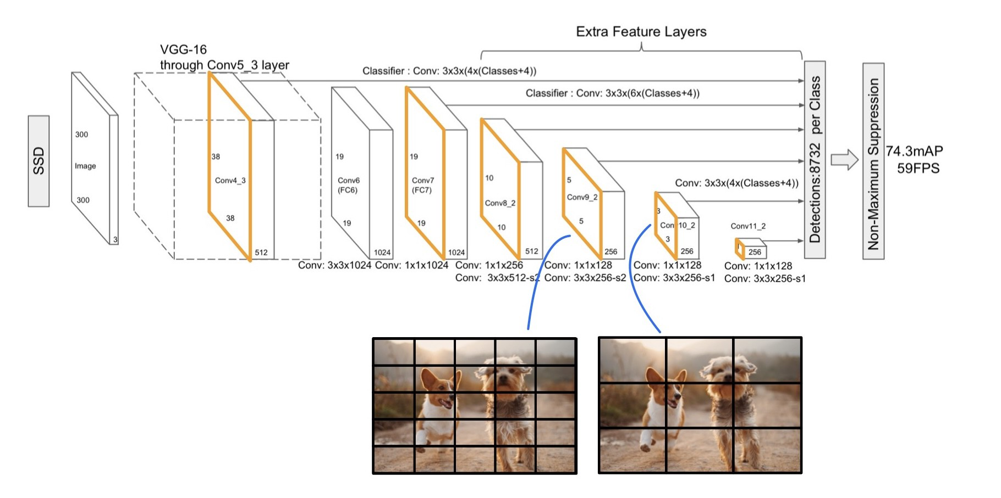
Detections at different locations

Slide 50
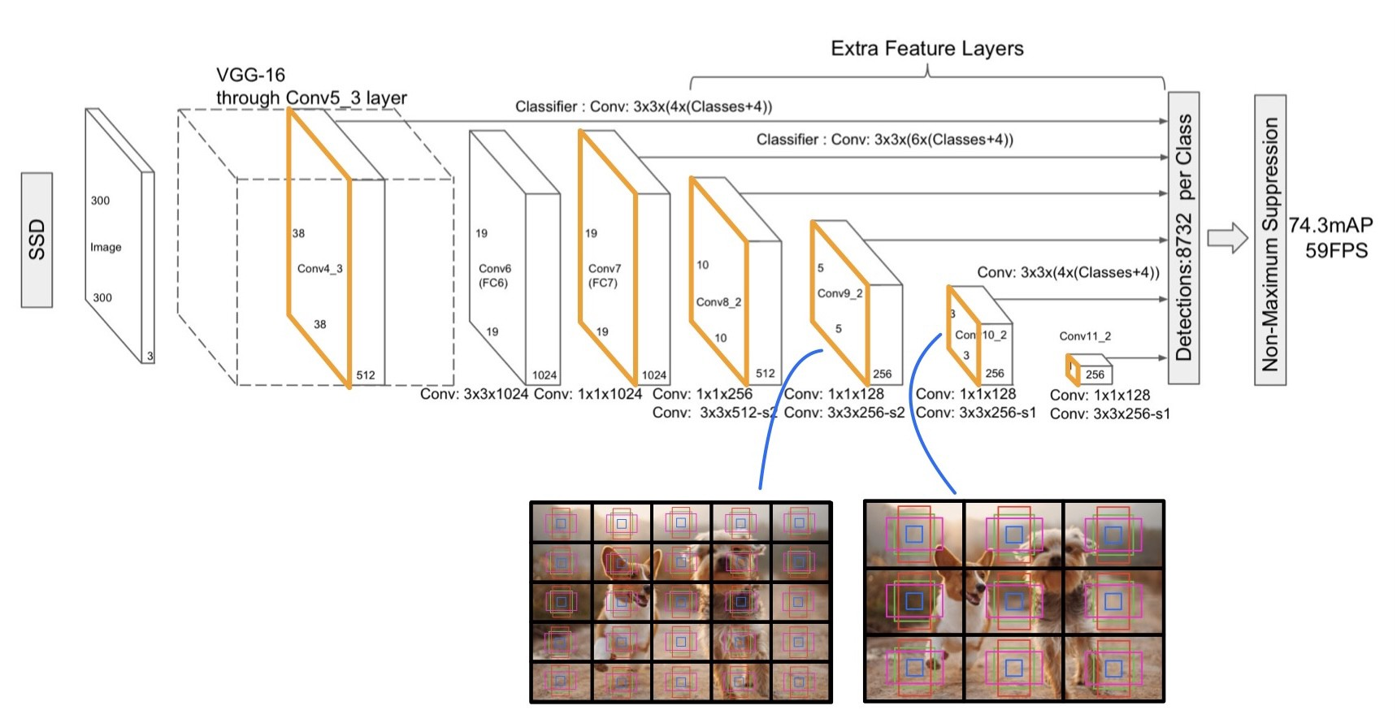
Detections at different locations with Anchor boxes

Slide 51
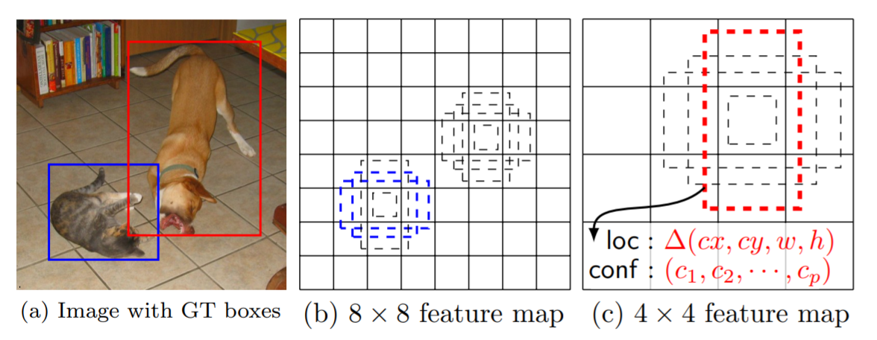
Anchor box helps in Identifying Objects of different sizes at different sized feature map

Slide 52
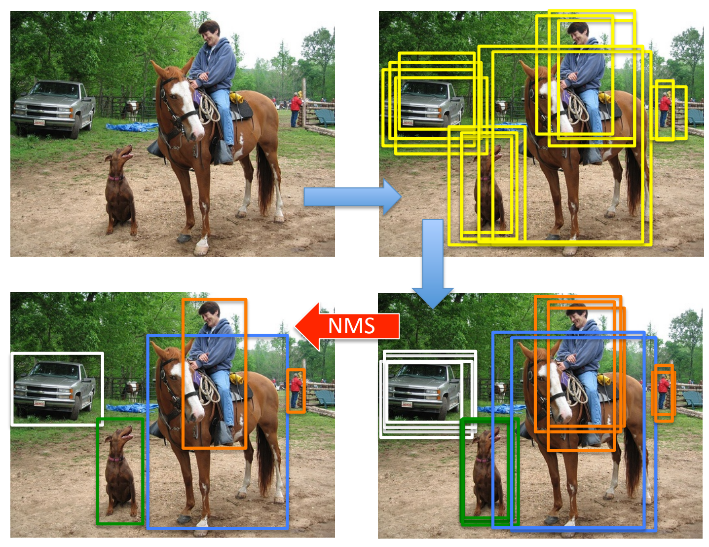
NMS Non Max Suppression
Bounding Box regression
with Anchors
Identifying Object class in
detected Anchor box

Slide 53
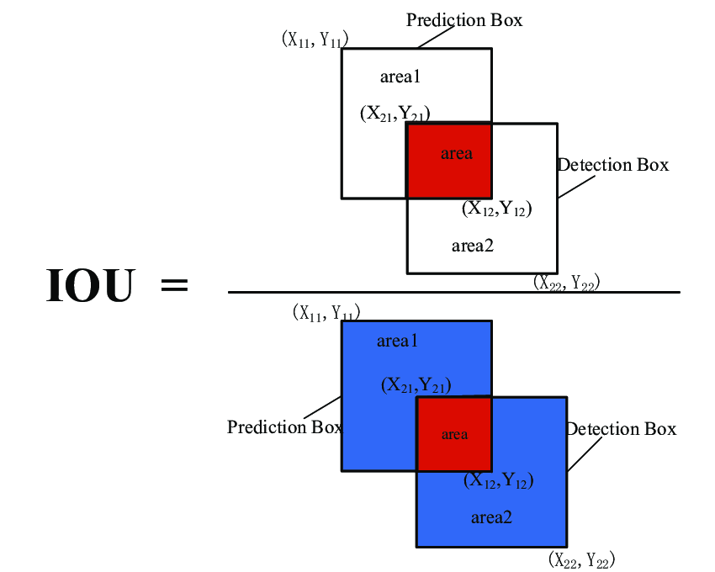
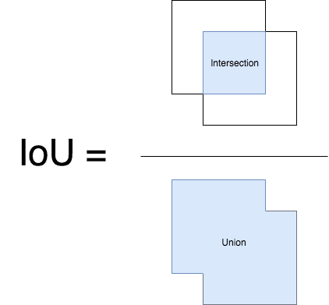
Intersection over Union (IOU) Calculation

Slide 54
Working principle of NMS:
Input: A list of Proposal boxes B, corresponding confidence scores S and overlap threshold N.
Output: A list of filtered proposals D.
Algorithm:
Select the proposal with highest confidence score, remove it from B and add it to the final proposal list D. (Initially D is empty).
Now compare this proposal with all the proposals — calculate the IOU (Intersection over Union) of this proposal with every other proposal. If the IOU is greater than the threshold N, remove that proposal from B.
Again take the proposal with the highest confidence from the remaining proposals in B and remove it from B and add it to D.
Once again calculate the IOU of this proposal with all the proposals in B and eliminate the boxes which have high IOU than threshold.
This process is repeated until there are no more proposals left in B.

Slide 55
NMS, threshold: 0.9
D
B
1
1
2
1,2 -> IOU: 0.8 < 0.9
1,3 -> IOU:0.95 > 0.9 -> remove 3 from B
1,4->
score/Conf 1 > 3 ..
and IOU > threshold

Slide 56
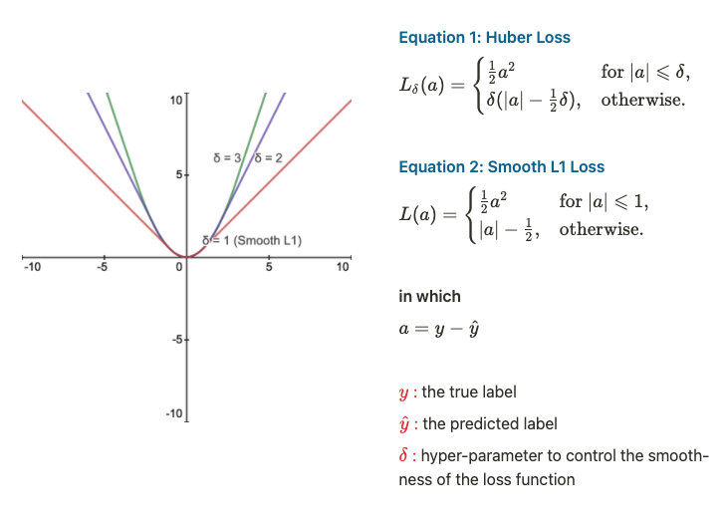
Regression & Classification Loss Function:
Smooth L1 Loss Function:
Regression loss function.
It is used in SSD
It is a special case of Huber Loss
with δ = 1.
It is a combination of
L1 Loss and L2 Loss.
When |a| is less than or equals to 1 -> L2 loss
Otherwise, it behaves like L1 loss.

Slide 57
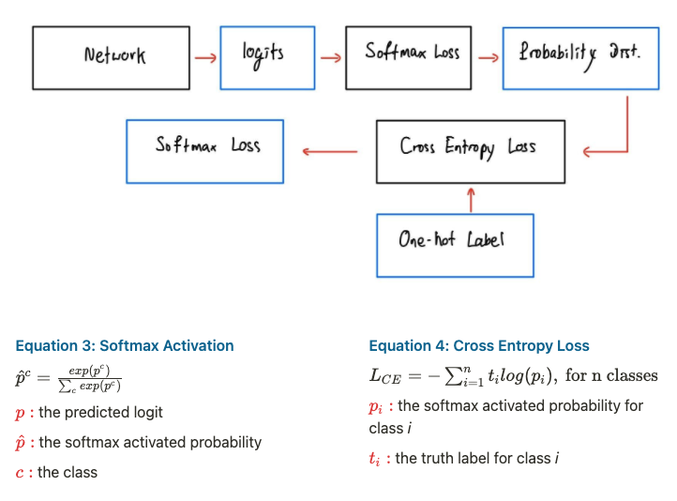
Softmax Loss (a.k.a. Categorical Cross Entropy Loss)

Slide 58
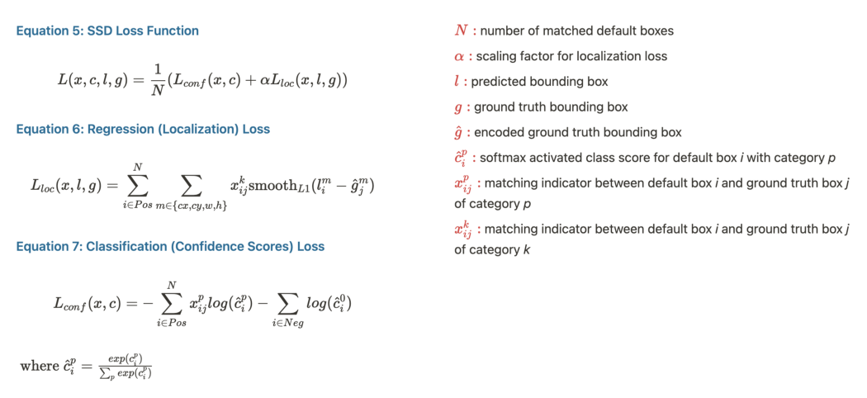

Slide 59
Object detection Challenges
COCO (80 classes):
https://cocodataset.org
Pascal VOC (20 classes)
http://host.robots.ox.ac.uk/pascal/VOC/voc2012/

Slide 60
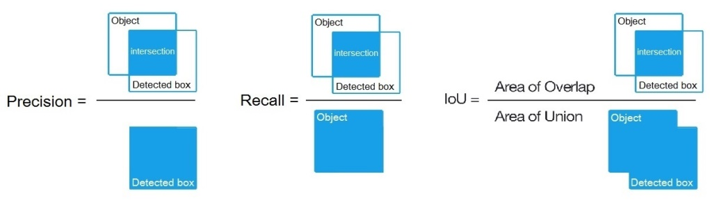
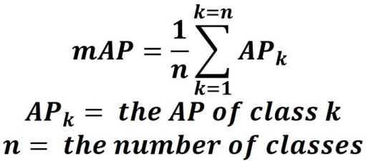
Metrics Object Detection: link
Calculate Precision and Recall
Precision and Recall curves -> ROC Curve
Calculating Average Precision for each class
Average Precision -> (Area under the ROC curve)
Methods to calculate:
11 point intersection method link
All point intersection method
mAP: mean Average Precision of all classes link
Tensorflow Object detection model Zoo: TF1, TF2
Reference Links:
https://www.youtube.com/watch?v=QdWidmgLwbw&list=PL1GQaVhO4f_jLxOokW7CS5kY_J1t1T17S&index=12
https://www.youtube.com/watch?v=QdWidmgLwbw&list=PL1GQaVhO4f_jLxOokW7CS5kY_J1t1T17S&index=13
https://www.youtube.com/watch?v=t98TA2RYQvw&list=PL1GQaVhO4f_jLxOokW7CS5kY_J1t1T17S&index=14
https://www.youtube.com/watch?v=oz2dDzsbXr8&list=PL1GQaVhO4f_jLxOokW7CS5kY_J1t1T17S&index=15

Slide 61
Tensorflow Object Detection API

Slide 62
EyeBlink Detection
Problem statement
Just after taking picture detect any one closed eyes in picture, and notify to user “somebody closed eyes, take another picture”
Notes:
cropped face data: E:\2020\EllieService\Eye_Blink_detection\data
data and code_path: E:\2020\EllieService\Eye_Blink_detection\training_eb_v1

Slide 63

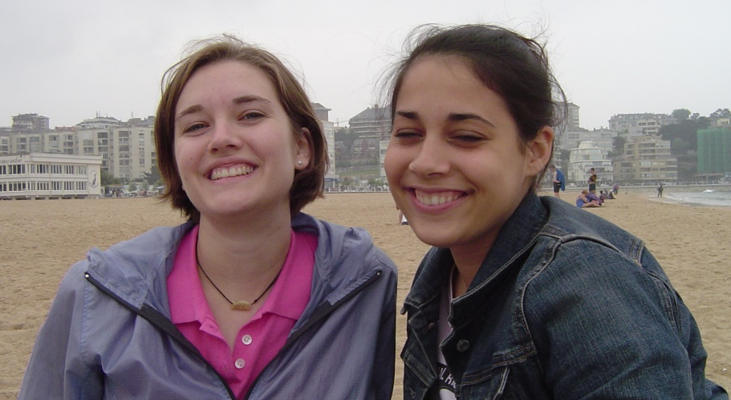

Two stage approach
Eye blink detection
Open eyes
Face Detection
40ms
Eye blink detection
Closed eyes
20ms
40ms
total time taken = 20ms (face-detection) + 40ms*(no.of faces detected)
Notes:
data_path: E:\2020\EllieService\Eye_Blink_detection\data

Slide 64
SSD approach
Open eyes
SSD
Eye-blink
detection
Closed eyes
60ms
total time taken ~= 60ms

Slide 65
Training Pipeline for SSD
ReadDoc link
Dataset Creation
Used OpenCV Face-detector and old eyeblink detector model (Binary Image classifier) to label Images
Used Python Scripts to convert Face bounding boxes and labels to xml files
Installing Obj_detect API
Converting Dataset to TFRecords
xml to csv
(images + csv) to TFRecords
selecting and downloading Pre-trained model in model zoo : TF1, TF2
Training with Transfer learning
Evaluating model checkpoints
Exporting Checkpoints to frozen graph file (frozen_graph.pb file)
Converting frozen_graph.pb to eyeblink_detect.tflite model -> deploy in mobile

Slide 66
Reference Links:
SSD Original paper:
https://arxiv.org/pdf/1512.02325.pdf
Bounding Box Regression:
https://arxiv.org/pdf/1904.06805.pdf
Article from basics of Object detection and SSD:
https://towardsdatascience.com/implementing-ssd-in-keras-part-i-network-structure-da3323f11cff
https://towardsdatascience.com/implementing-single-shot-detector-ssd-in-keras-part-ii-loss-functions-4f43c292ad2a
https://towardsdatascience.com/implementing-single-shot-detector-ssd-in-keras-part-iii-data-preparation-624ba37f5924
https://towardsdatascience.com/implementing-single-shot-detector-ssd-in-keras-part-iv-data-augmentation-59c9f230a910
https://towardsdatascience.com/implementing-single-shot-detector-ssd-in-keras-part-v-predictions-decoding-2305a6e4c7a1
Code with good pictures:
https://dhruvs.space/posts/understanding-object-detection-part-4/

Slide 67
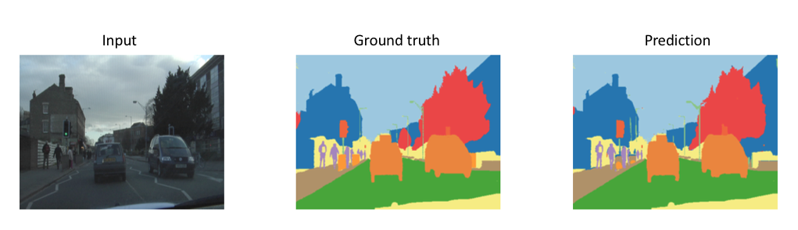
Image Segmentation
UNet
DeepLab v3

Slide 68
Usecases
Portrait mode:
https://ai.googleblog.com/2018/03/semantic-image-segmentation-with.html
https://ai.googleblog.com/2017/10/portrait-mode-on-pixel-2-and-pixel-2-xl.html
https://ai.googleblog.com/2018/03/mobile-real-time-video-segmentation.html

Slide 69
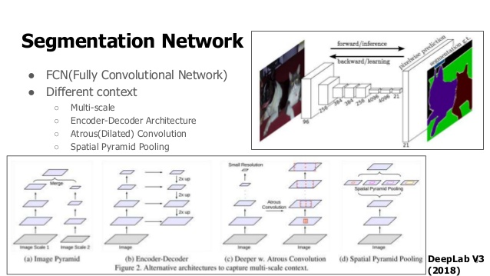

Slide 70

UNET

Slide 71
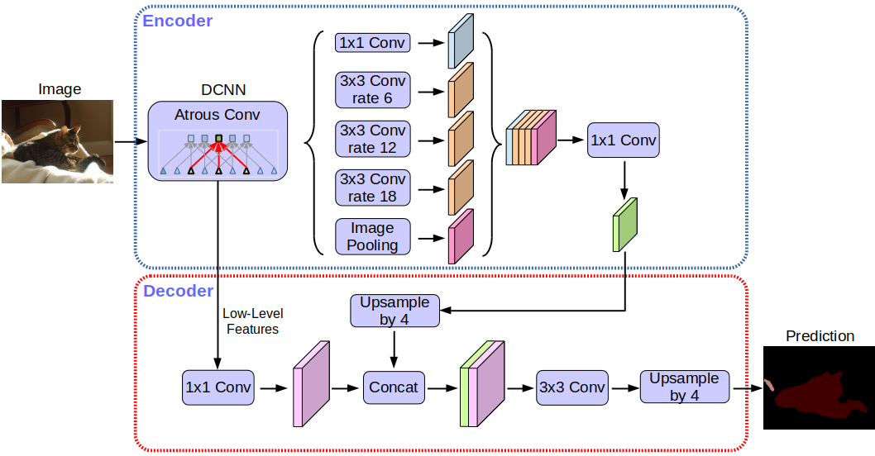
Deeplab

Slide 72
Challenges and datasets
https://www.cityscapes-dataset.com/
https://cocodataset.org/#detection-2020
https://cs.stanford.edu/~roozbeh/pascal-context/
https://research.mapillary.com/eccv18/
https://groups.csail.mit.edu/vision/datasets/ADE20K/
Android App sample:
https://www.tensorflow.org/lite/examples/segmentation/overview

Slide 73
Reference Links
TF example:
https://www.tensorflow.org/tutorials/images/segmentation
Unet paper:
https://arxiv.org/pdf/1505.04597.pdf
DeepLab-v3
https://ai.googleblog.com/2018/03/semantic-image-segmentation-with.html
Analysis on DeepLab models on different datasets:
http://collab.lge.com/main/x/vsVERg

Slide 74
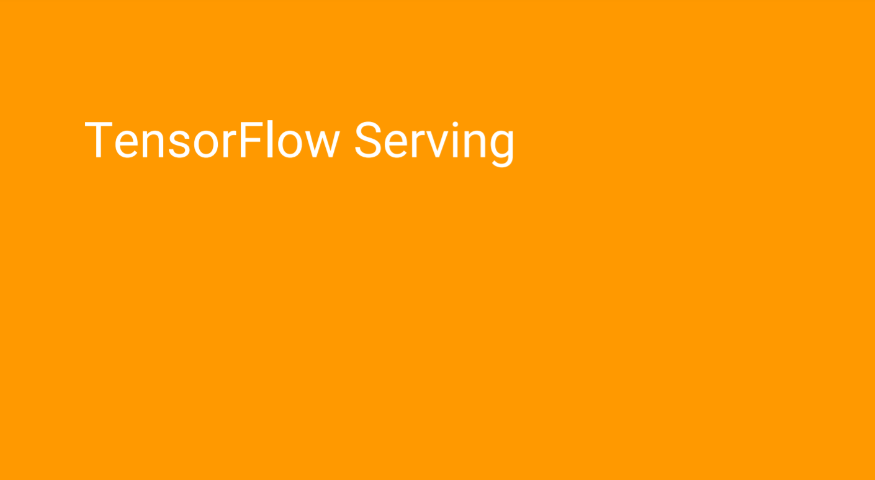

Slide 75


Slide 76

link: https://pytorch.org/tutorials/intermediate/flask_rest_api_tutorial.html

Slide 77

Connecting multiple clients

Slide 78


Slide 79


Slide 80


Slide 81
Saving a Keras model as Saved model
MODEL_DIR = './model'
version = 1
export_path = os.path.join(MODEL_DIR, str(version))
print('export_path = {}\n'.format(export_path))
tf.keras.models.save_model(
model,
export_path,
overwrite=True,
include_optimizer=True,
save_format=None,
signatures=None,
options=None
)
print('\nSaved model:')

Slide 82


Slide 83


Slide 84
Reference Links
Saving keras model to saved_model
https://www.tensorflow.org/tfx/tutorials/serving/rest_simple
https://www.tensorflow.org/tfx/serving/docker
https://www.tensorflow.org/guide/saved_model
https://towardsdatascience.com/serving-image-based-deep-learning-models-with-tensorflow-servings-restful-api-d365c16a7dc4

